Slide 1
Code Structure & Coding conventions

Slide 2

Directory Structure
The project directory should contain:
- include - for header(.h/.hpp) files
- src - for source (.c/.cpp) files
- obj - for object (.o/.obj) files
- test - for test files (.c/.cpp - having main())
- bin - for executable files
- lib - for libraries (.a/.so)
Optional:
- docs - for documentation files
- config - for config files

Slide 3
Header File Guidelines
1. Header self-sufficiency: All dependencies should be added in headers. Include all dependent headers in class header file and not in class source file. Class source file should only include the class declaration header (.h file).
eg. httpAuth.cpp should only contain {#include “httpAuth.h”} and no other includes.
2. Header Modularity: Headers should be functionally divided into multiple classes.
Eg. If we need to do a simple functionality of taking input from user, processing it and giving output back to user, we can create 3 different classes. As the processing tasks increases, we can then create multiple classes for the same.
3. No global vars: Avoid declaring and using global variables as they can be modified and accessed anywhere in the whole program. If someone still needs it, all global vars should be declared in a single header file containing nothing else. Its easier to manage.
4. Meaningful params: Use meaningful params in function declaration.
Eg. Use ‘int subtract(int lho, int rho);’ instead of ‘int subtract(int, int) in function decl. In the first example, we know that the function is subtracting two numbers and we also know the position of those operands in the equation, thus we can say that the function will return the result of this operation: lho - rho But in second example, we dont know the context representation of those params and user may provide wrong data to the params.

Slide 4
Header File Guidelines (Continued)
Commenting
- doxygen commenting style in class member function declarations
- Atleast one line of comment for each data member declared
Header file structure
/*
* Copyright: Vehant Technologies (P) Ltd COPYRIGHT NOTICE
*/
/*
* test.h
* ------------------
* This is a sample header file. HEADER FILE INFO
*
* Initial Author: G Anoop
*/
#ifndef _TEST_H_ HEADER GUARD START
#define _TEST_H_
.
.
declarations
.
.
#endif //_TEST_H_ HEADER GUARD END

Slide 5
Source File Guidelines
1. Modularity : One source file for one header file implementation ( same name ). Dont make multiple source files for a single header file or vice versa.
2. Readability : Source file must not exceed 1000 lines. Create more helper classes or refactor the code as and when required.
3. Functionality: All the required functionalities should be implemented in classes in header files and main() should only call them, not exceeding 10-15 lines.
Eg. there are 3 main tasks, we need to perform: input, process, output
Then main should only call input(), process(), output() (defined in single/multiple class). The actual implementation of the task should be done in classes only.
4. Comments: Src files should also contain copyright notice and function implementations should have step by step commenting, more if required or complex logic.
Say if input, process, output are implemented in a single function:
Eg. // Step - 1 : Taking input
--- Code for taking input ---
// Step - 2: Process input
--- Code for processing input ---
// Step - 3: Redirect process output (to display screen or anything)
--- Code for redirect ---
5. All preprocessor directives should start from 1st coln of the line. Do not indent preprocessor directive lines of code.
6. Relative path to be used in includes. Only use relative paths in files and use -I(capital-i) in g++ command for the same.
eg. #include <libjpeg/jpeglib.h> √
#include </opt/libjpeg/jpeglib.h> ×

Slide 6

General Guidelines
1. Comment all decisions made in implementation. (Step-by-step commenting)
2. Including headers:
- System Level : #include <>
- local : #include “”
3. Avoid multiline comments ( /* ... */ )
- Similar style used by doxygen (check doxygen style)
- Causes nesting problems
4. #else, #endif, #elif should have comment tags
Eg. #ifdef THIS_FILE
--- Some Code ---
#endif // THIS_FILE <- This is comment tag
5. Do not use #ifdef, #if blocking the scope of code
(Dont do the left one, follow right one)
Eg. while(x) while(x)
{ // Scope start #if SOMETHING
#if SOMETHING { .... } } // Scope end - broken scope #else
#else { .... }
} // Scope end #endif
#endif
6. Indentation is must. Use 2 spaces gap as indentation.
7. A line should not contain more than 80 characters of code

Slide 7
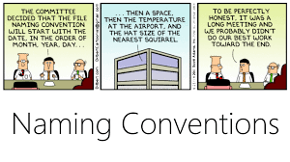
Naming Convention
1. FILES
- Meaningful, 6-15 characters long. cuddlyCaps (eg httpAuth.h/cpp)
- No use of _(underscore).
2. Identifiers
- Meaningful, avoid single letter vars like i,j,k (can be used in small loops)
- Classes and structs MixedCaps (class HttpAuth)
- Member functions cuddlyCaps (void receiveData())
- Data members m_cuddlyCaps / m_pMixedCaps
(Http* m_pHttp or Http m_http)
- Global vars cuddlyCaps_g (int globalAppState_g)
- Local vars cuddlyCaps (int localVariable)
- Suffixes for similar type of functions/data vars (avoid overloading)
eg. int SqRootI(int num) & double SqRootD(double, double)
3. Avoid redefinition with the use of namespaces

Slide 8

Coding Style
1. 80 characters in single line: Break it like below
variable = expression1 + expression2 +
expression3;
2. Functions should only handle one thing (less than 100 lines, best 30 lines)
3. Avoid mixing C and C++ codes, use extern “C”
4. Encourage using pass by reference instead of pass by value.
Reuses address instead of copying data into new memory (thus, faster processing)
int sum(int a, int b); ×
int sum(const int& a, const int& b); √
5. Place ‘{‘ below the new scope (like if, for, do-while, while)
if (a < b)
{
...
}
else
{
...
}
6. Declare and assign Variables where they are used, and not at
the starting of the function.

Slide 9

Coding Style (continued)
1. Use FIXME for code which needs to be fixed in the near future.
eg-> // FIXME
// Hardcoded something, need to change it to user input
2. Use TODO for code that you need to do in future
eg-> // TODO
// Need to do Implementation for some APIs
2. Avoid using exit(), instead return error codes,
if exited abruptly, we may miss the data which is required for debugging the issue.
3. Each function should return a int value( 0 for success, less-than 0 for errors and greater-than 0 for warnings) if it is not doing one of the things below:
- Computing something eg. sum(1,2);
- Returns bool eg. isFileInDirectory(filename, dir);
- Returns Pointer eg. createNewObject(flags/ctx);
4. Avoid using getters/setters in the class. Use context instead for getting data from outside, and set the context inside the class.
This enables the user easier usage of the functionality of class
5. In case context cannot be used, define
SetProperty(string*, string*) which will can be used
for setting data to the class object.
*string can be replaced with any other general var

Slide 10
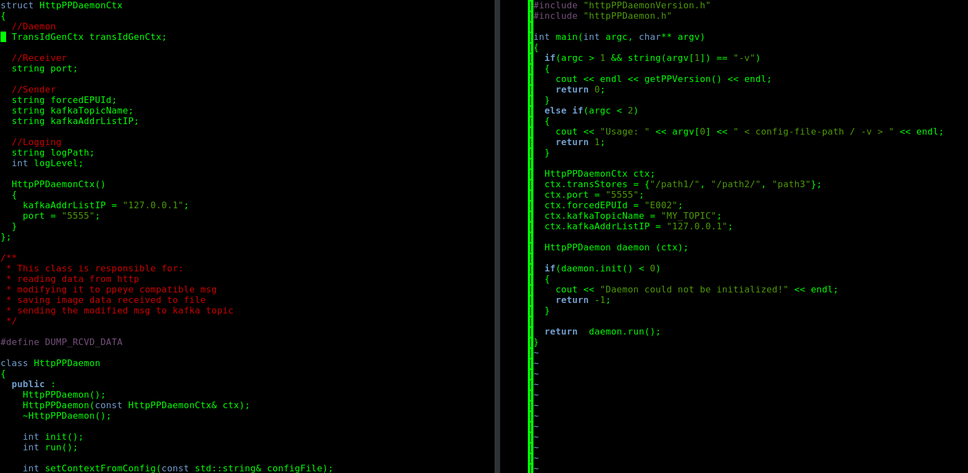
CONTEXT Example
<= CONTEXT Decl.
<= Setting context
<= Providing context
<= CONTEXT Param func.

Slide 11
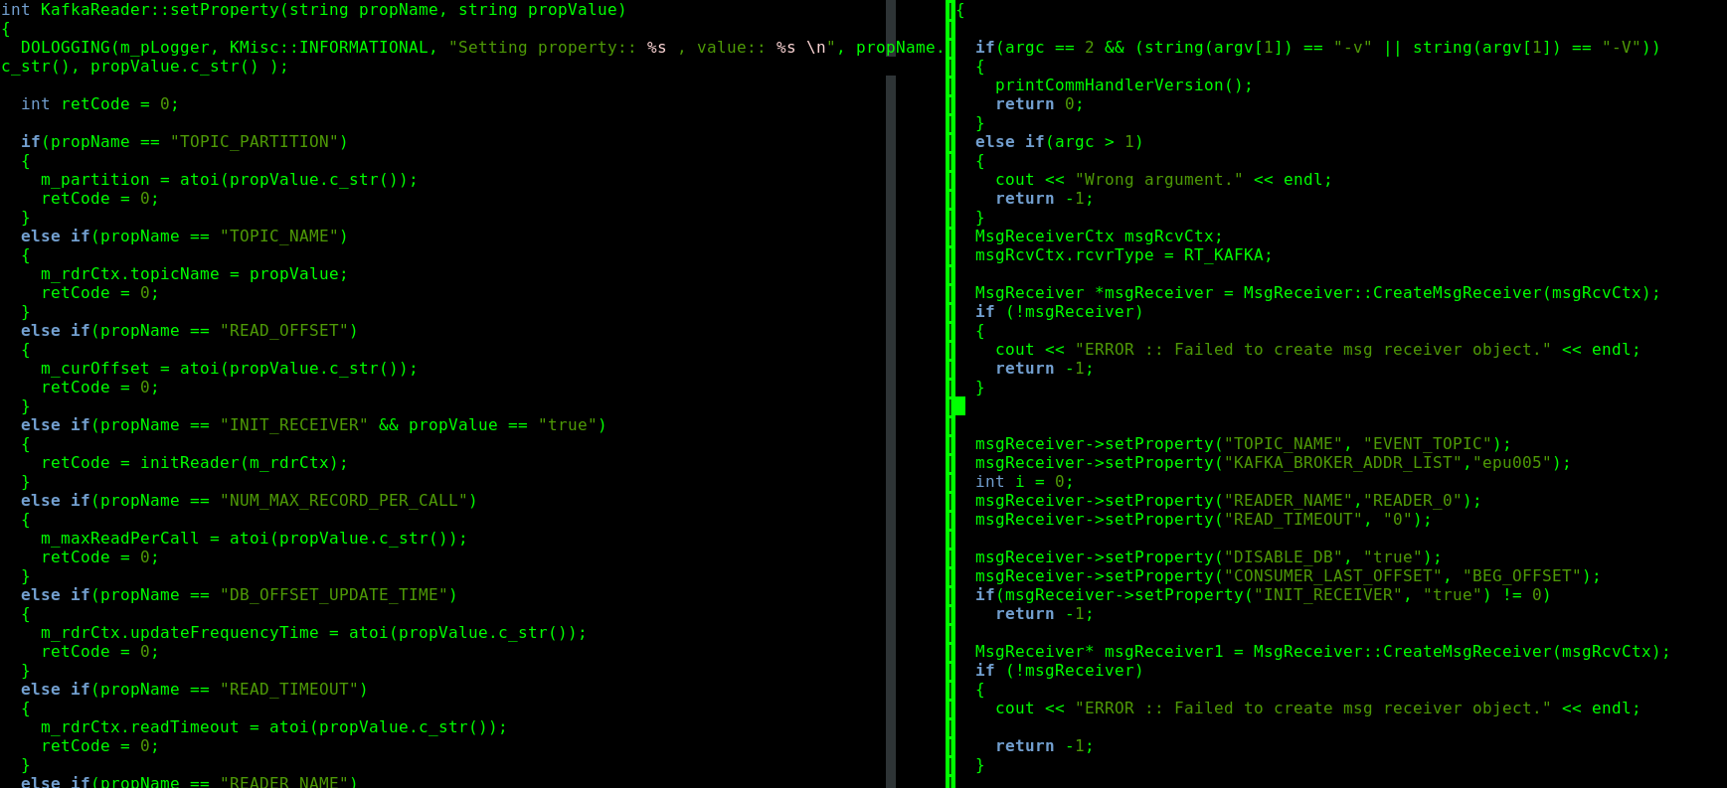
SETPROPERTY Example (in this ex, KafkaReader is a subclass of MsgReceiver)
<= Defined Properties
<= Defined Properties
<= Setting Property

Slide 12
CONTEXT Advantages
1. Any number of variables can be added in a context
2. Can be used as single parameter in any function which can replace all the parameters in that function
3. Can be changed without modifying anything in class declaration
SETPROPERTY Advantages
1. Can be used for providing context in case of inherited class (sub class)
2. Any number of properties can be defined in implementation(cpp) file
3. A single setProperty() can be implemented in base class which is inherited and overridden by sub class and can be used for setting specific properties for that object.
4. Can be changed without modifying anything in class declaration

